Slide 1
N4 RECOVERY TEAM WEEK3

Slide 2
OBJECTIVES
ANALYSIS OF EJECTION MECHANISMS 3
CHOOSING MECHANISM 4
PARACHUTE DESIGN 5
TELEMETRY AND FLIGHT STATE TRANSITION 6
EJECTION,PDB AND CONTROL CIRCUIT 11

Slide 3
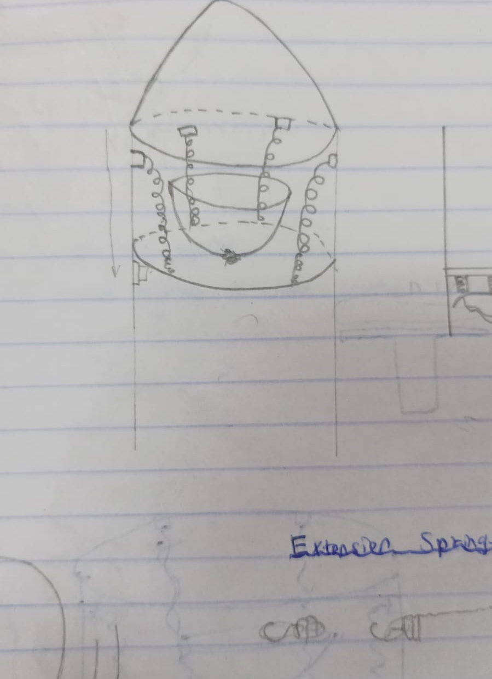
Analysis of ejection mechanisms

Slide 4
Criteria for choosing a Bands
Travel Distance
The band should be able to extend to cover the required range of motion dictated by the device's operational needs.
Material Selection
Choosing a material that can withstand the stresses within elastic limits to avoid failure.
Size and Weight of load
The Bands must be capable of handling a load prudence, which for this project is a minimum of 10N.
Mounting Location
Band must fit within the allocated space in the device without interference.
Note: Rubber bands are elastic solids; they are thought to follow a simplified version of Young’s modulus. Hooke's Law (below) is classically applied to spring systems.

Slide 5
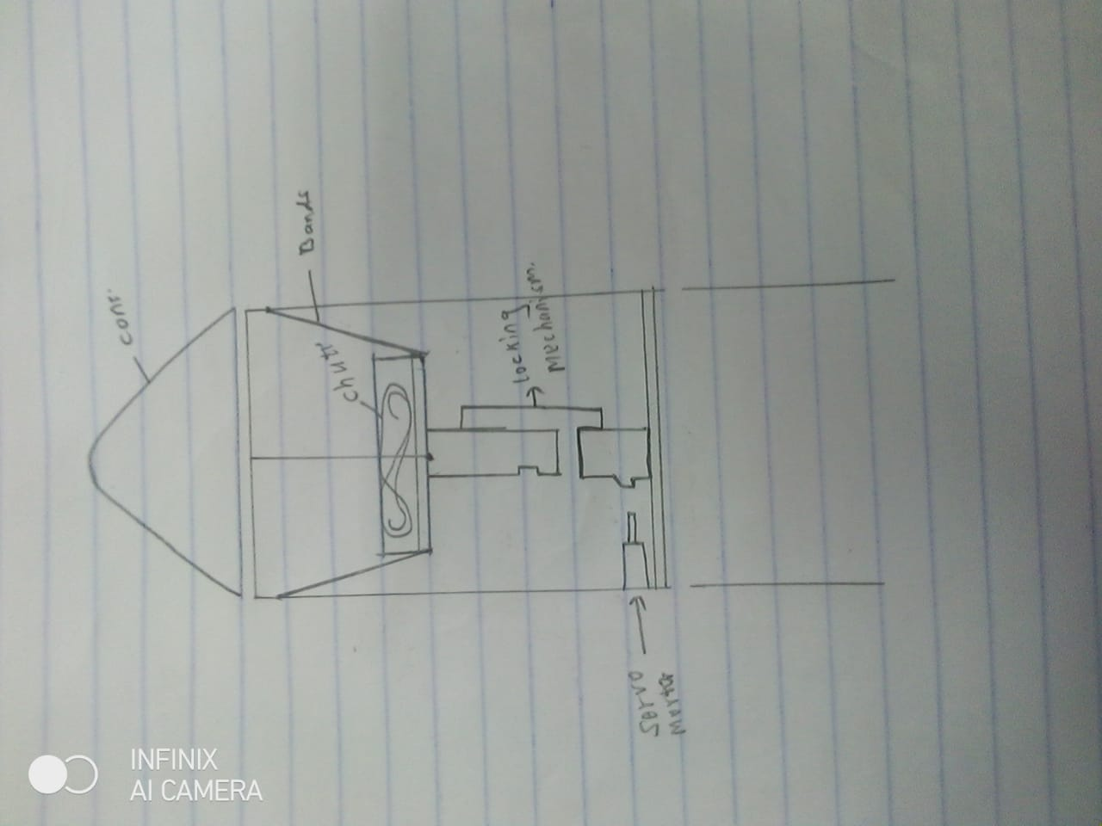
Bands on ejection mechanism

Slide 6

Locking system of the Ejection Mechanism
Loading will be done manually and bands stretches and locking occurs
Servo motors will be used to unlock the system, the bands retract ejecting the parachute.
https://a360.co/44StTs2

Slide 7
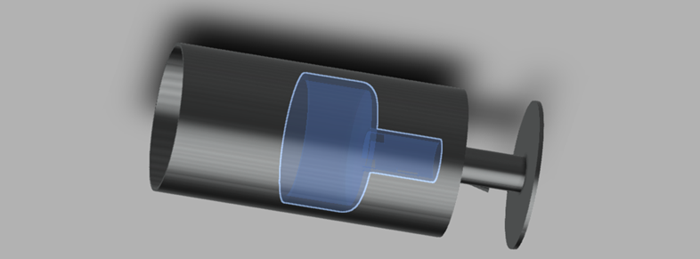
Drogue Housing
The drogue housing attached to the locking system

Slide 8
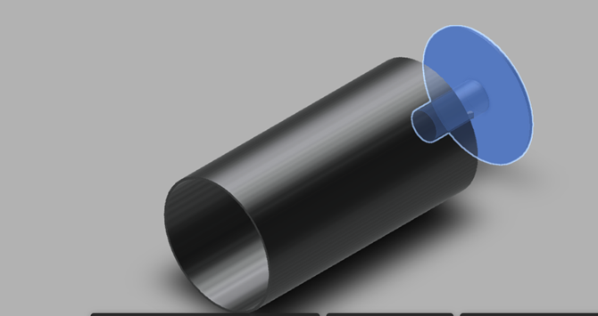
The base of the locking system will be fixed permanently the airframe

Slide 9
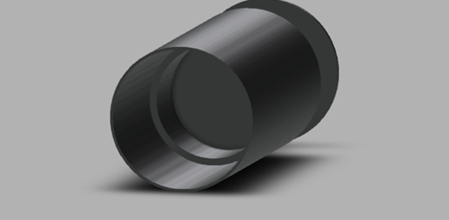
Bands will be attached to the airframe from the inside

Slide 10
Telemetry and Flight state transition
Technical Specifications and Code

Slide 11
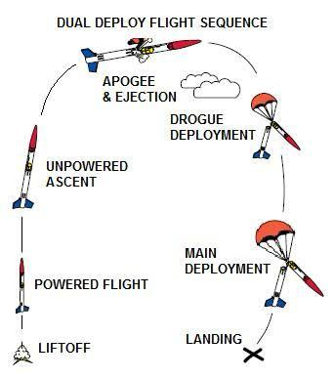
Flight Mode Differentiation
Details the different flight state conditions like Safe mode, Flight mode , Apogee, and Drogue deploy.
Code Considerations
Focus :
Transition conditions in code -efficient state transitions between flight modes.
Dead Reckoning :
Predict position
GYROSCOPE and ACCELEROMETER

Slide 12
Initial code Issues
Flight state machine transition conditions
Differentiating safe mode and flight mode
Unique identification of each of the rockets
Dead Reckoning

Slide 13
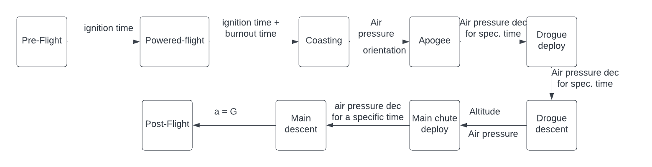
Flight state machine transition conditions

Slide 14
Differentiating safe mode and flight mode
SAFE MODE | FLIGHT MODE
PRE-FLIGHT POST-FLIGHT | POWERED-FLIGHT COASTING APOGEE DROGUE DEPLOY DROUE DESCENT MAIN CHUTE DEPLOY MAIN CHUTE DESCENT

Slide 15
Flight Computer

Slide 16
Benchmark Table
Components | University of Maryland | University of Nevada | University of Florida | West Virginia | University at Buffalo
Battery | LiPO | LiPO | LiPO | N/A | LiPO
Camera | N/A | N/A | Mobius mini | N/A | Raspberry Pi
Antenna | Yagi-Uda | N/A | Yagi | N/A | N/A
GPS | Feather weight | RTX | Telegps | BigRedBee | MTK339
Ejection | black powder | black powder | black powder | black powder | black powder

Slide 17
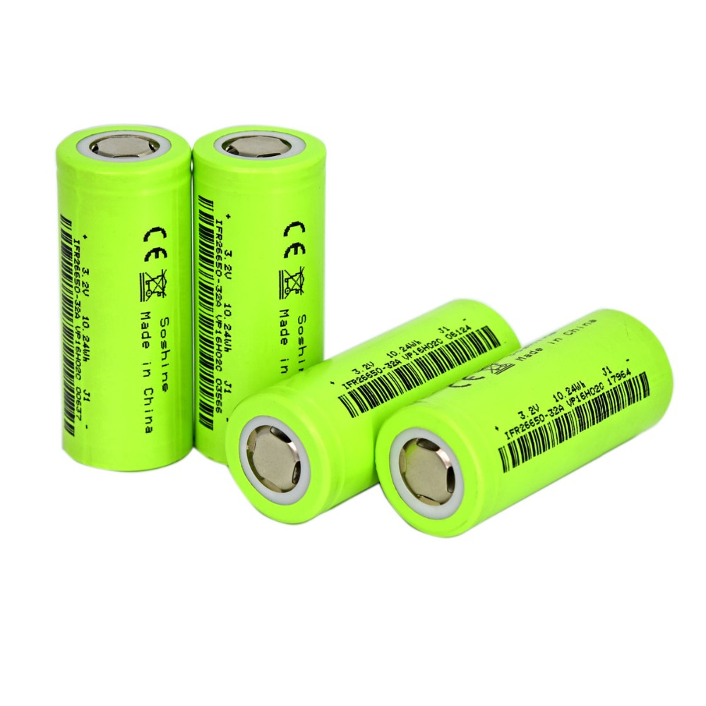
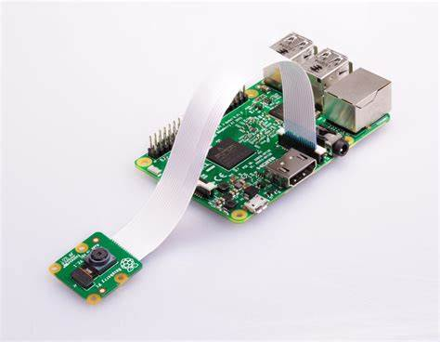
Choice of components
BATTERY
LiFePO4 26650 3.2V 3200mAh
CAMERA
Raspberry pi

Slide 18
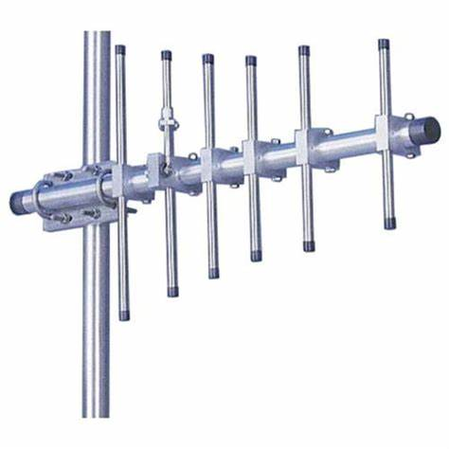
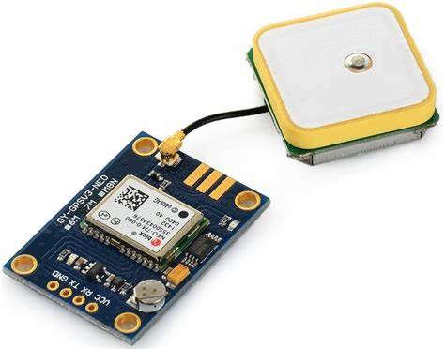
Choice of components cont.
ANTENNA
Yagi-uda
GPS
Neo 6M

Slide 19
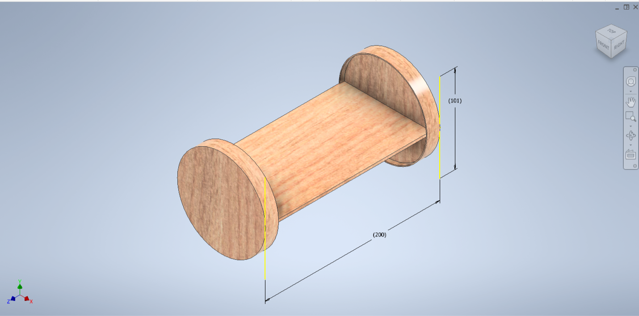
Avionics Bay Design
Plywood will be used

Slide 20
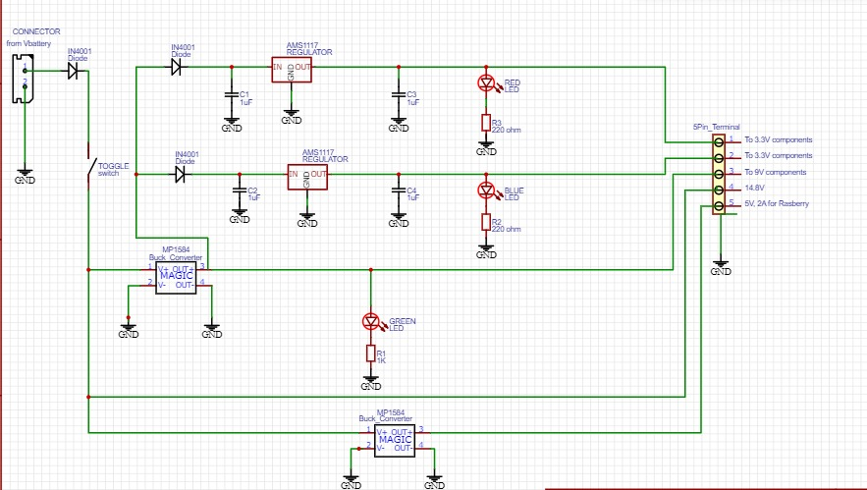
Power Distribution Board
Battery
Diodes
Regulators
LEDs
Buck convertors
Capacitors
Resistors

Slide 21
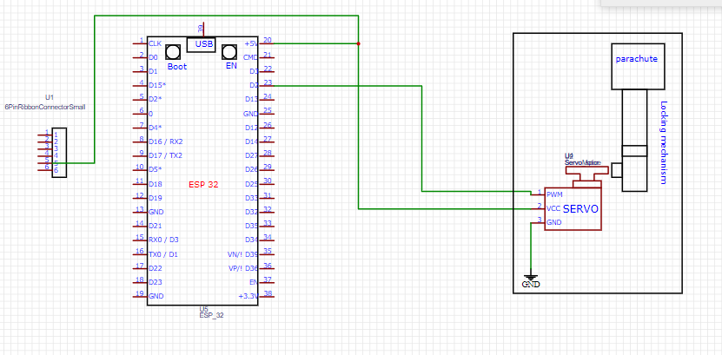
Ejection circuit

Slide 22
thank you

